Slide 1

Session 2 – Introduction to Angular Guest Lecture Series for NIBM Students
Uthpala Pathirana | 22 Apr 2021

Slide 2

HOLA!
Uthpala Pathirana Software Engineer at Ascentic
I graduate from IIT, and I have 5 years experience working as a Full Stack Engineer on .NET technologies and Angular
https://www.linkedin.com/in/uthpala-pathirana/

Slide 3


Agenda
Angular ?
Comparison
Hands on

Slide 4
What is Angular ?
FREAMEWORK
SINGLE PAGE APPLICATION
REACTIVE

Slide 5

Angular Versioning
AngularJs – Angular 1 (2006)
Complete rewrite
Angular 2 – (2015)
Angular 4
New version every 6 months
….
Angular 11

Slide 6
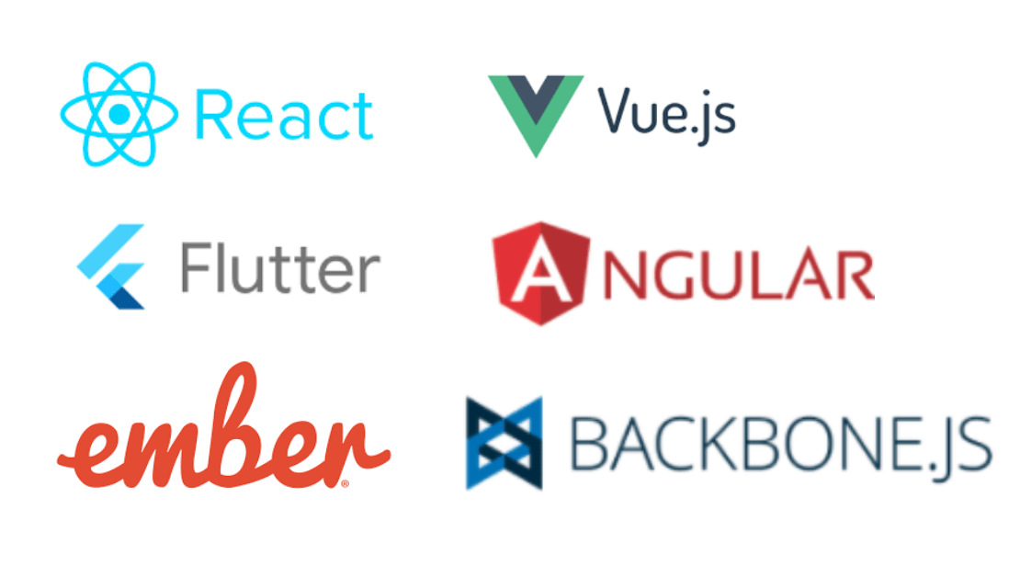
Front-end Technologies

Slide 7
Angular vs React vs Vue.js
Framework | Pros | Cons
React | UI Library, Stable releases for huge user volumes, most famous, Updates are far easier to upscale to | Only for front-end solutions, The learning curve is steep, Frequent updates, View oriented-ness
Angular | Front-end Framework, Views are pure HTML pages, components are reusable, two way data binding, better design architecture | The learning curve is steep, Limited SEO options
Vue.js | Two-way data binding, Easy learning curve, The structure of vue.js allows to reuse UI components even in other projects | Instability in components, too much flexibility leads to irregularities in coding efforts, Smaller community, Language barrier on some libraries and docs
Source: https://novateus.com/top-front-end-frameworks-2021

Slide 8
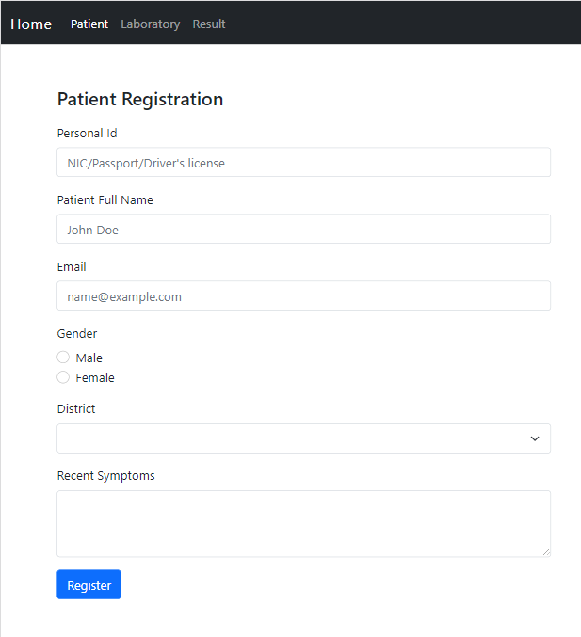
Use Case
Patient Registration Page
Dashboard with charts
Test Result table view

Slide 9
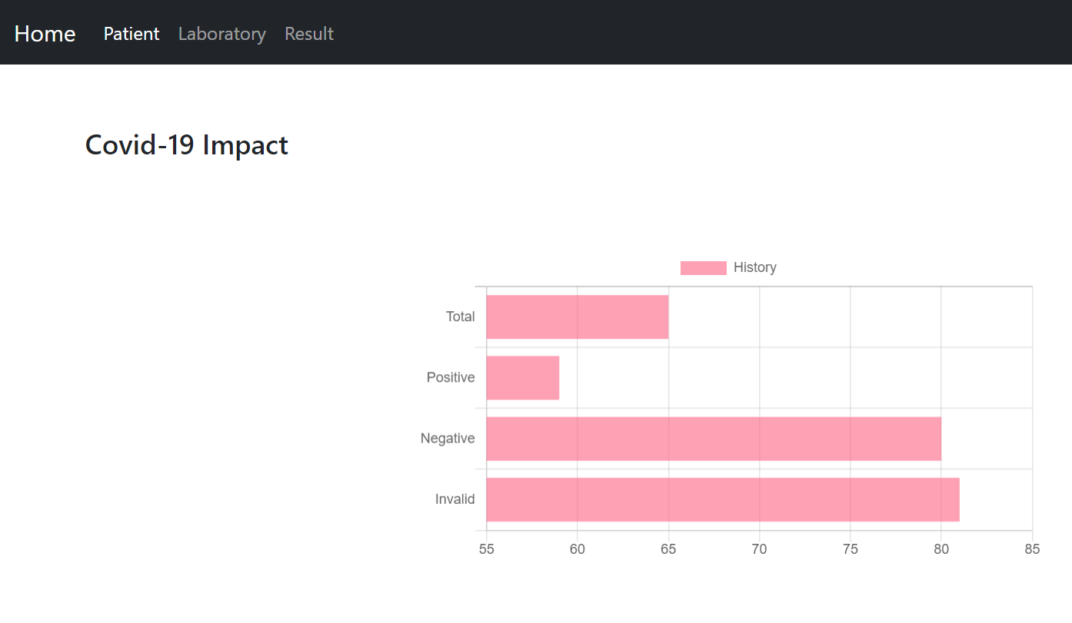
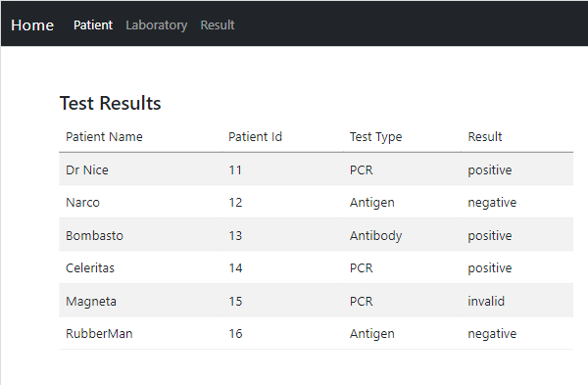
Use Case

Slide 10
Angular Installation
Node.js
Node Package Manager
Angular CLI
VS Code - IDE

Slide 11
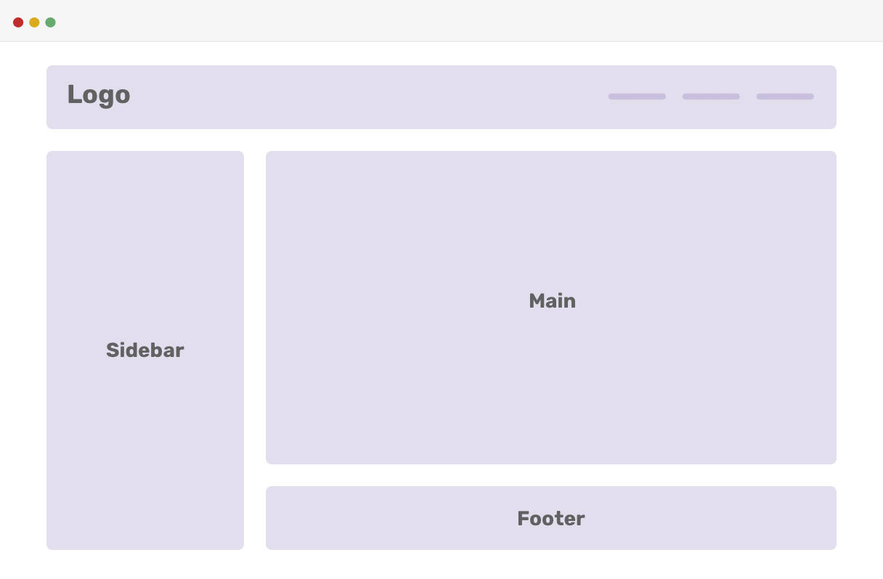
Components

Slide 12

First Application

Slide 13
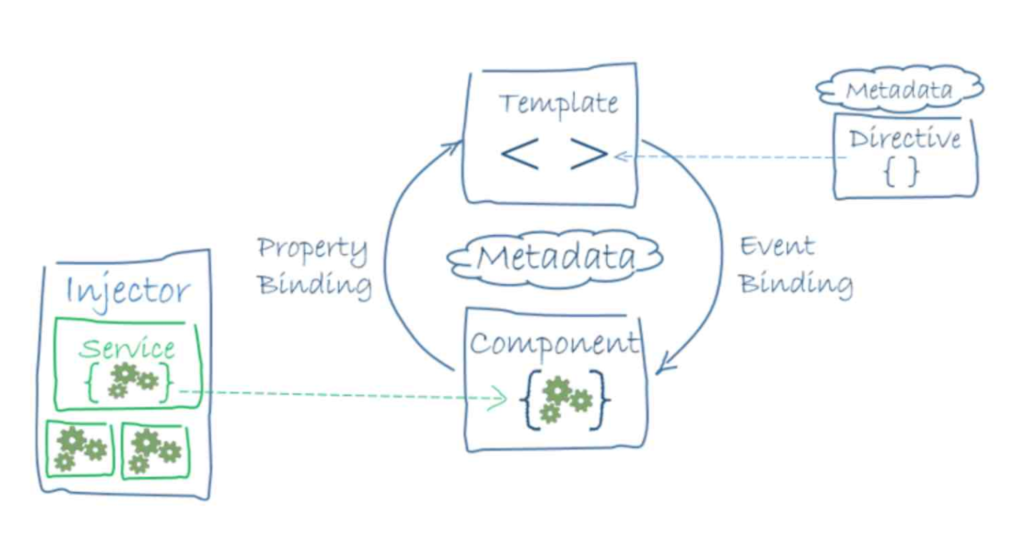
Angular Magic
Two-way Data Binding
Component-based architecture

Slide 14
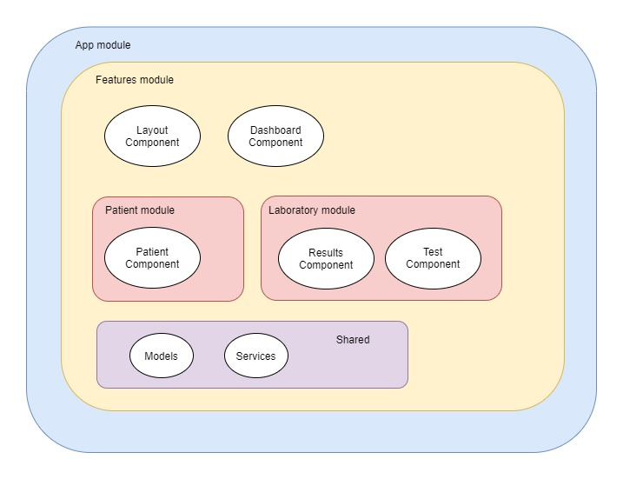
Module Overview

Slide 15
Exercises
Try to create a form to enter laboratory test result
Try one of the forms as a reactive form

Slide 16
Next Session
Reactive form with validation
Component Lifecycle
Pipes

Slide 17

THANK YOU!

Slide 18

HELP US IMPROVE

